Slide 1
LLMs and RAG
Hants Williams, PhD, RN

Slide 2
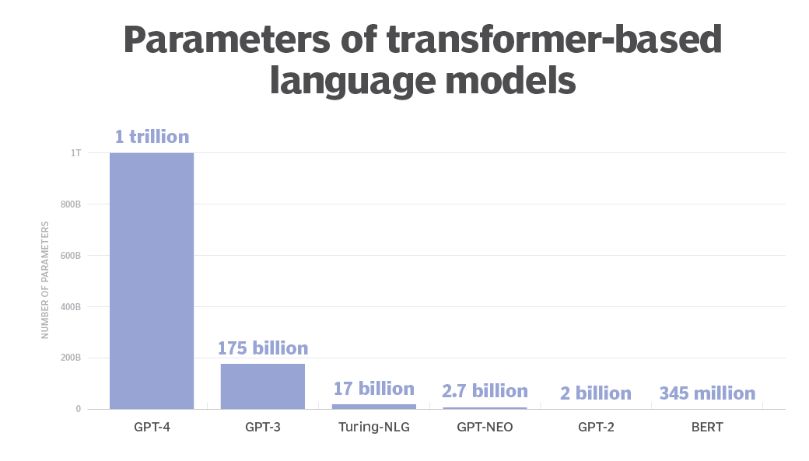
What is a LLM
A large language model (LLM) is a type of artificial intelligence program that can recognize and generate text, among other tasks.
LLM are very large models that are pre-trained on vast amounts of data.
It can perform completely different tasks such as answering questions, summarizing documents, translating languages and completing sentences.
Chat GPT 4 has approximately ~1 TRILLION parameters
Built on transformer architecture is a set of neural network that consist of an encoder and a decoder with self-attention capabilities.
Parameters: elements of the model that are learned from the training data, that used to make predictions or generate text. These parameters are numerical values stored within the model's architecture, and they dictate how the model processes and responds to input data.

Slide 3
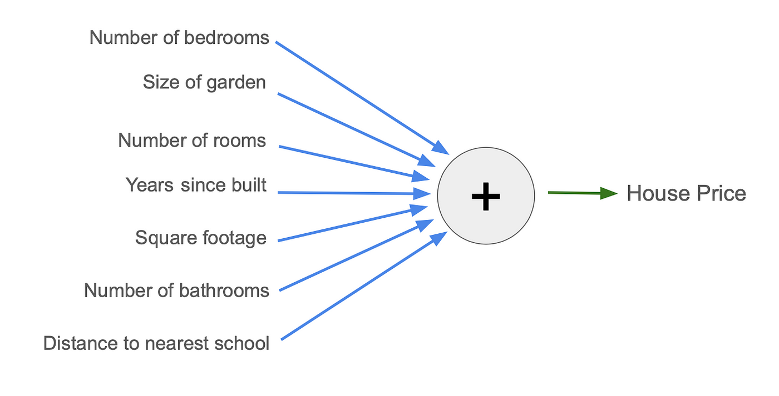

Slide 4
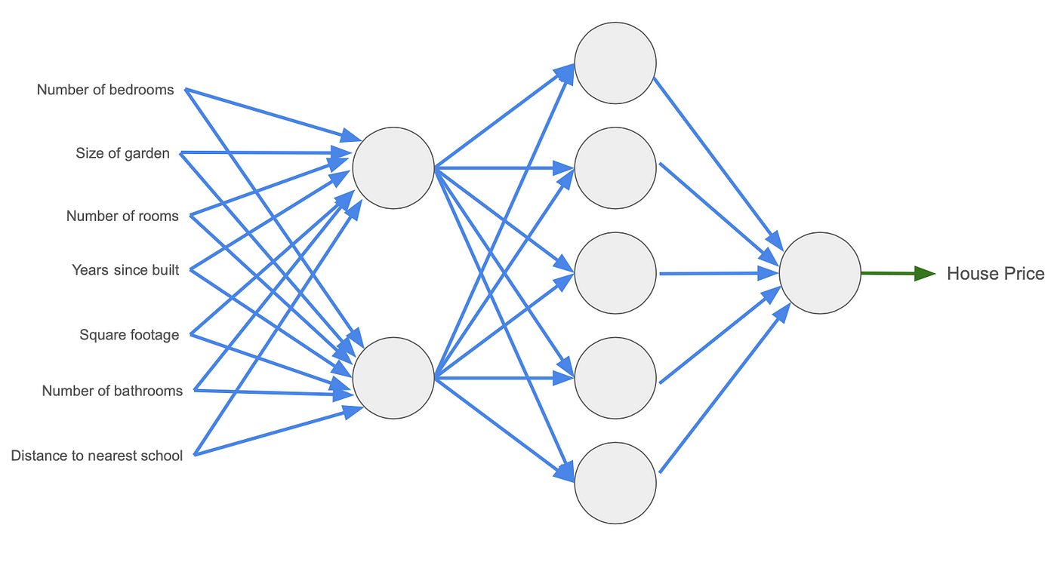
LLMs are neural network models. 3 layers, with 7 inputs. The first layer has 2 nodes, the second layer has 5, and the last layer has 1. Each blue line is a parameter.
Hidden Layer
Input Layer
Hidden Layer
Node
Output
Node

Slide 5
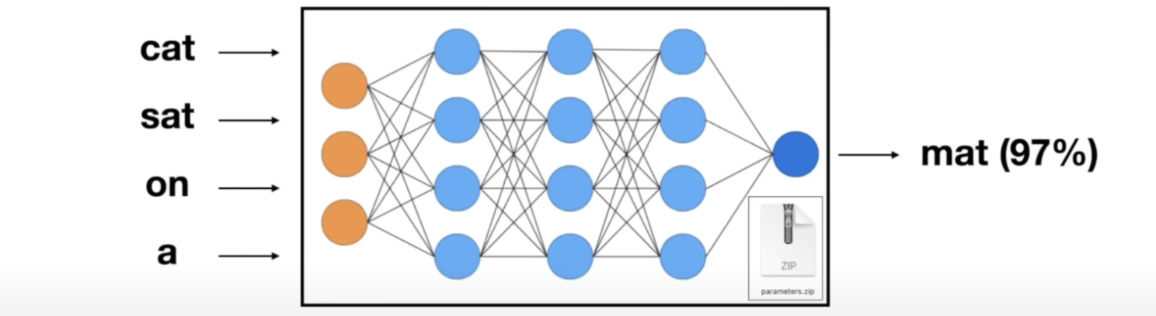
LLMs use words as inputs and outputs, and they use a mechanism called ‘attention’ to determining ‘what comes next….’
4 words….predict the next logical word
IMAGINE 1 TRILLION PARAMETERS (connecting lines)

Slide 6
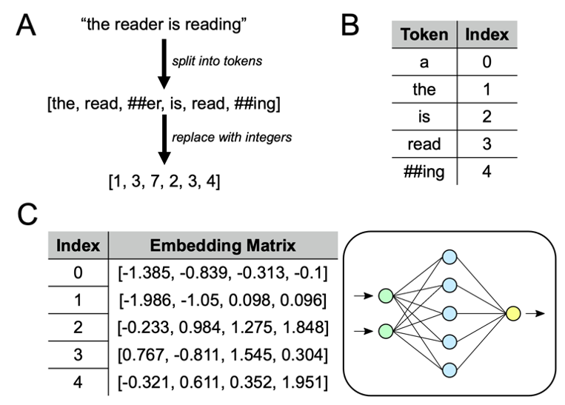
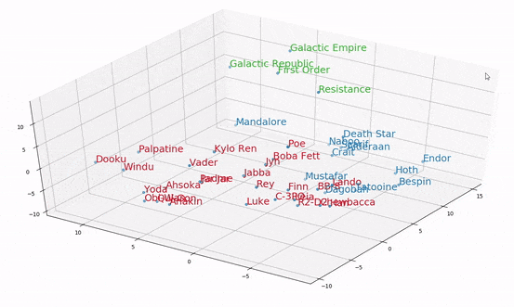
…cat sat on a
Tokenization
Embedding
C. Embedding Matrix
….main goal of embeddings is to capture semantic, syntactic, and contextual meanings of words in a way that is easily processable by machine learning models.

Slide 7
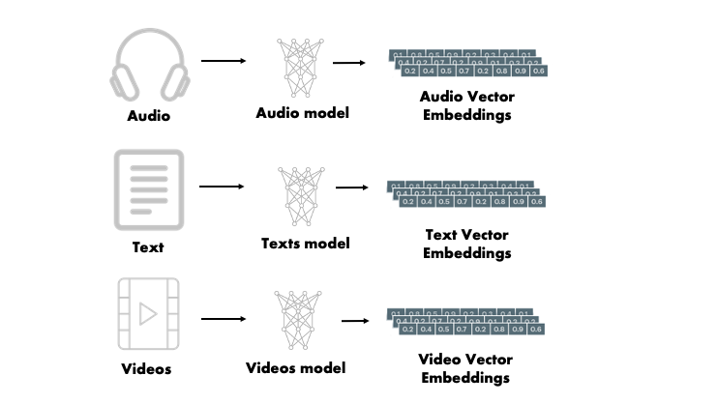
https://python.langchain.com/docs/integrations/text_embedding/

Slide 8
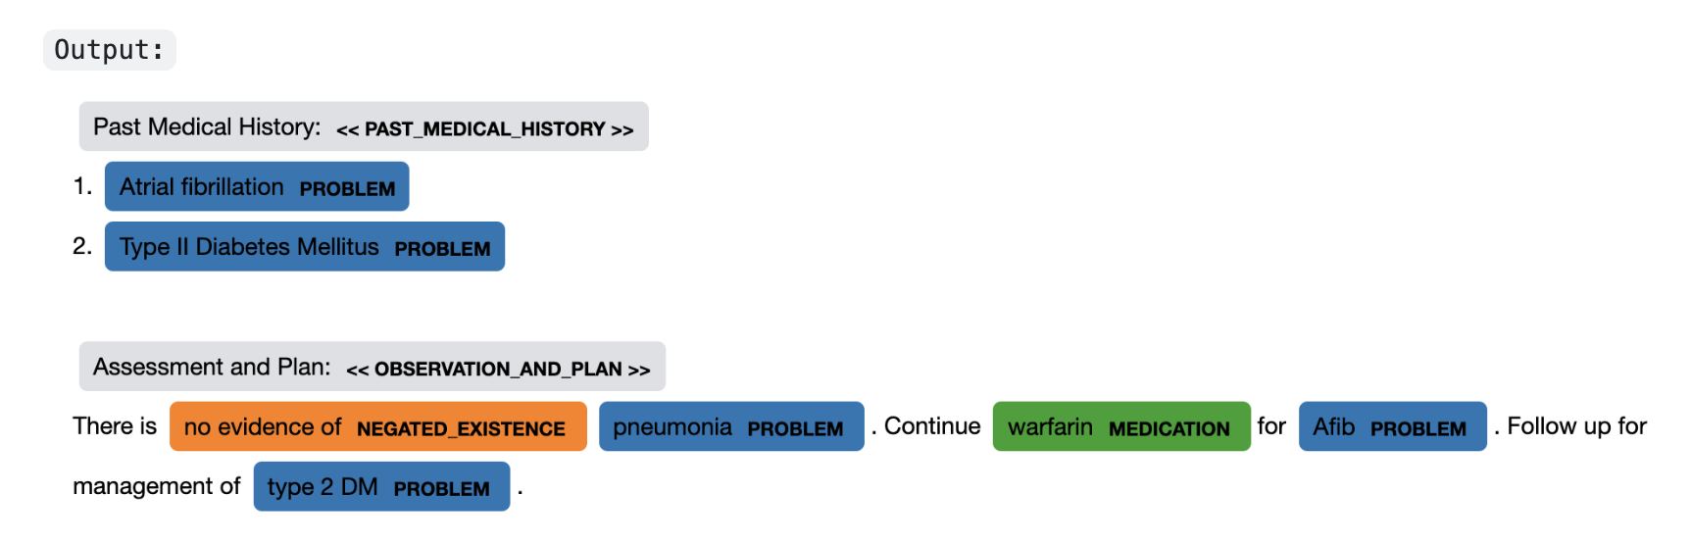
Example of standalone embedder: SpacY (MedSpacy)
text = """ Past Medical History: 1. Atrial fibrillation 2. Type II Diabetes Mellitus Assessment and Plan: There is no evidence of pneumonia. Continue warfarin for Afib. Follow up for management of type 2 DM. """
https://github.com/medspacy/medspacy

Slide 9
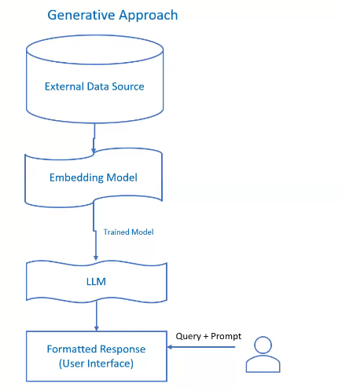
Embeddings in LLMs: Contextualization:
One of the key advantages of using embeddings in LLMs is the ability to modify these embeddings throughout the layers of the model. Unlike static embeddings, where the vector for a word remains the same regardless of context, LLMs dynamically adjust the embeddings as they pass through the layers, allowing the model to generate context-sensitive representations.
For instance, the word “bank” would have the same initial vector in "river bank" and "bank account," but as it passes through the layers of an LLM, its representation is adjusted to fit the context provided by surrounding words.

Slide 10
Growing # Open Source LLMs
Llama 2 (meta)
Grok (twitter/x/tesla)
Mistral (former deepmind/France)
Bloom (hugging face)
BERT (google)
Falcon (united arab emirates)
Xgen (salesforce)
Costs for development/building LLM from scratch:
- Would call these ‘foundational’ models
- OpenAI will build you your own LLM starting at 2-3 million
- General estimates from ‘internet’ – as info is secret:
- PalM (google): 10-20 million
- Llama 2: 20 million
- GPT3: 10 million
- GPT4: 100 million

Slide 11
Limitations
Not Updated to the latest information: Generative AI uses large language models to generate texts and these models have information only to date they are trained. If data is requested beyond that date, accuracy/output may be compromised.
Hallucinations: Hallucinations refer to the output which is factually incorrect or nonsensical. However, the output looks coherent and grammatically correct. This information could be misleading and could have a major impact on business decision-making.
Domain-specific most accurate information: LLM's output lacks accurate information many times when specificity is more important than generalized output. For instance, organizational HR policies tailored to specific employees may not be accurately addressed by LLM-based AI due to its tendency towards generic responses.
Source Citations: In Generative AI responses, we don’t know what source it is referring to generate a particular response. So citations become difficult and sometimes it is not ethically correct to not cite the source of information and give due credit.
Updates take Long training time: information is changing very frequently and if you think to re-train those models with new information it requires huge resources and long training time which is a computationally intensive task.
Presenting false information when it does not have the answer.

Slide 12
RAG
RAG stands for Retrieval-Augmented Generation
It's an advanced technique used in Large Language Models (LLMs)
RAG combines retrieval and generation processes to enhance the capabilities of LLMs
In RAG, the model retrieves relevant information from a knowledge base or external sources
This retrieved information is then used in conjunction with the model's internal knowledge to generate coherent and contextually relevant responses
RAG enables LLMs to produce higher-quality and more context-aware outputs compared to traditional generation methods
Essentially, RAG empowers LLMs to leverage external knowledge for improved performance in various natural language processing tasks
Retrieval Augmented Generation (RAG) is an advanced artificial intelligence (AI) technique that combines information retrieval with text generation, allowing AI models to retrieve relevant information from a knowledge source and incorporate it into generated text.

Slide 13
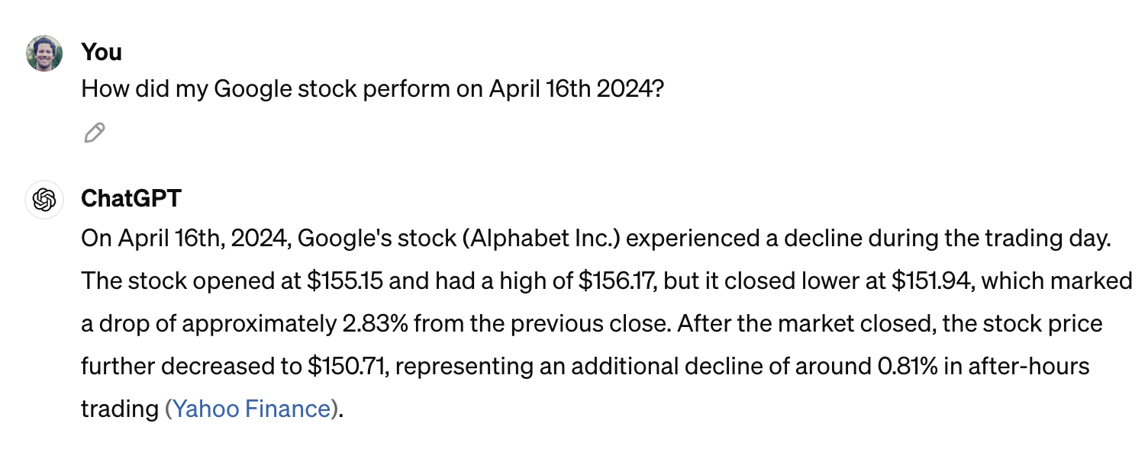
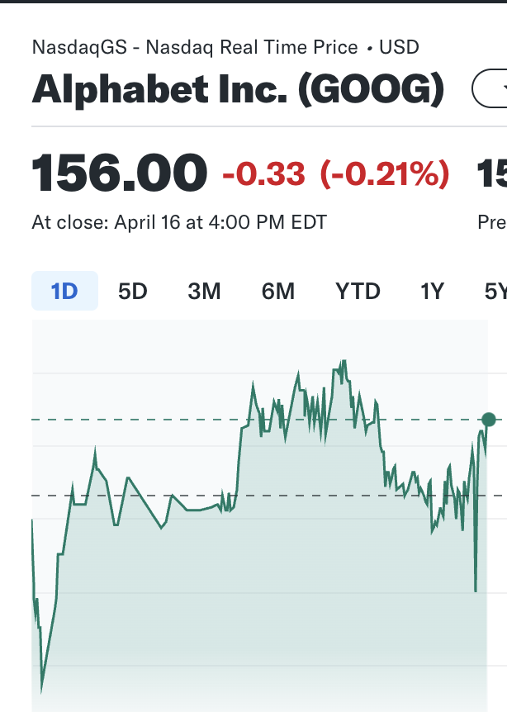
Why Important
You can think of the LLM as an over-enthusiastic new employee who refuses to stay informed with current events but will always answer every question with absolute confidence.Unfortunately, such an attitude can negatively impact user trust and is not something you want your chatbots to emulate!
RAG is one approach to solving some of these challenges. It redirects the LLM to retrieve relevant information from authoritative, pre-determined knowledge sources.
Organizations have greater control over the generated text output, and users gain insights into how the LLM generates the response.

Slide 14
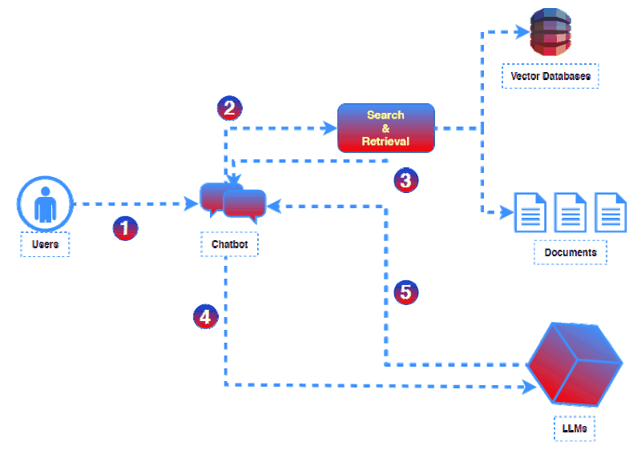
Simple…RAG Architecture
1 𝗧𝗵𝗲 𝗣𝗿𝗼𝗺𝗽𝘁 : Users provide the initial prompt for the chatbot, outlining their expectations for the output. 2 𝗖𝗼𝗻𝘁𝗲𝘅𝘁𝘂𝗮𝗹 𝗦𝗲𝗮𝗿𝗰𝗵: An external program searches and retrieves contextual information from various sources such as document repositories, databases, or APIs. 3 𝗣𝗿𝗼𝗺𝗽𝘁 𝗔𝘂𝗴𝗺𝗲𝗻𝘁𝗮𝘁𝗶𝗼𝗻 : The retrieved context is injected into the original prompt, enriching it with factual and relevant data. 4 𝗜𝗻𝗳𝗲𝗿𝗲𝗻𝗰𝗲: The LLM generates responses with enhanced accuracy, leveraging the factual data. 5 𝗥𝗲𝘀𝗽𝗼𝗻𝘀𝗲: The LLM sends back the response to the chatbot, providing factually correct and contextually relevant information.

Slide 15
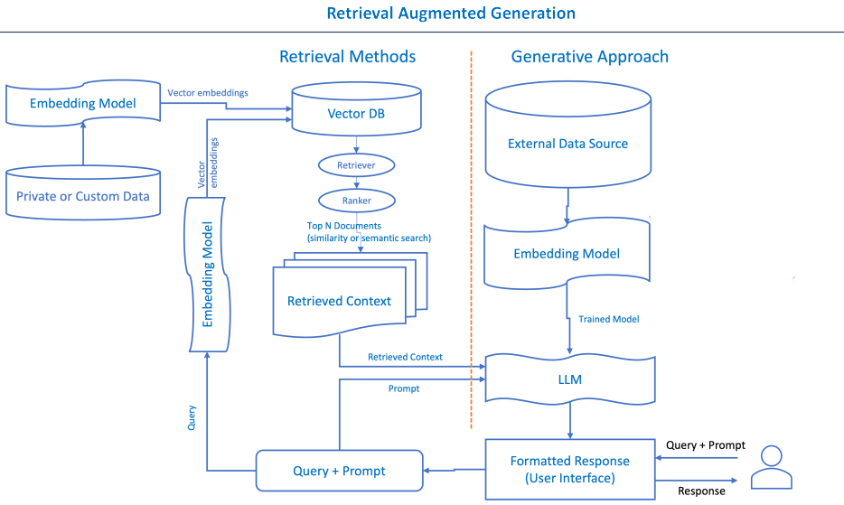
Detailed…RAG Architecture

Slide 16
Overview
Retrieval Augmented Generation (RAG) can be likened to a detective (retriever) and storyteller (generator) duo. Imagine you are trying to solve a complex mystery. The detective's role is to gather clues, evidence, and historical records related to the case.
Once the detective has compiled this information, the storyteller designs a compelling narrative that weaves together the facts and presents a coherent story. In the context of AI, RAG operates similarly.
The Retriever Component acts as the detective, scouring databases, documents, and knowledge sources for relevant information and evidence. It compiles a comprehensive set of facts and data points.
The Generator Component assumes the role of the storyteller. Taking the collected information and transforming it into a coherent and engaging narrative, presenting a clear and detailed account of the mystery, much like a detective novel author.
This analogy illustrates how RAG combines the investigative power of retrieval with the creative skills of text generation to produce informative and engaging content, just as our detective and storyteller work together to unravel and present a compelling mystery.

Slide 17
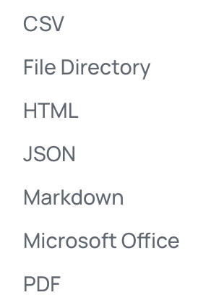
External Data
External data
The new data outside of the LLM's original training data set is called external data. It can come from multiple data sources, such as a APIs, databases, or document repositories. The data may exist in various formats like files, database records, or long-form text.
Vector embeddings
ML models cannot interpret information intelligibly in their raw format and require numerical data as input. They use neural network embeddings to convert real-word information into numerical representations called vectors.
Vectors are numerical values that represent information in a multi-dimensional space
Embedding vectors encode non-numerical data into a series of values that ML models can understand and relate. Example:
The Conference (Horror, 2023, Movie) The Conference (1.2, 2023, 20.0)
Tales from the Crypt (Horror, 1989, TV Show, Season 7) Tales from the Crypt (1.2, 1989, 36.7)

Slide 18
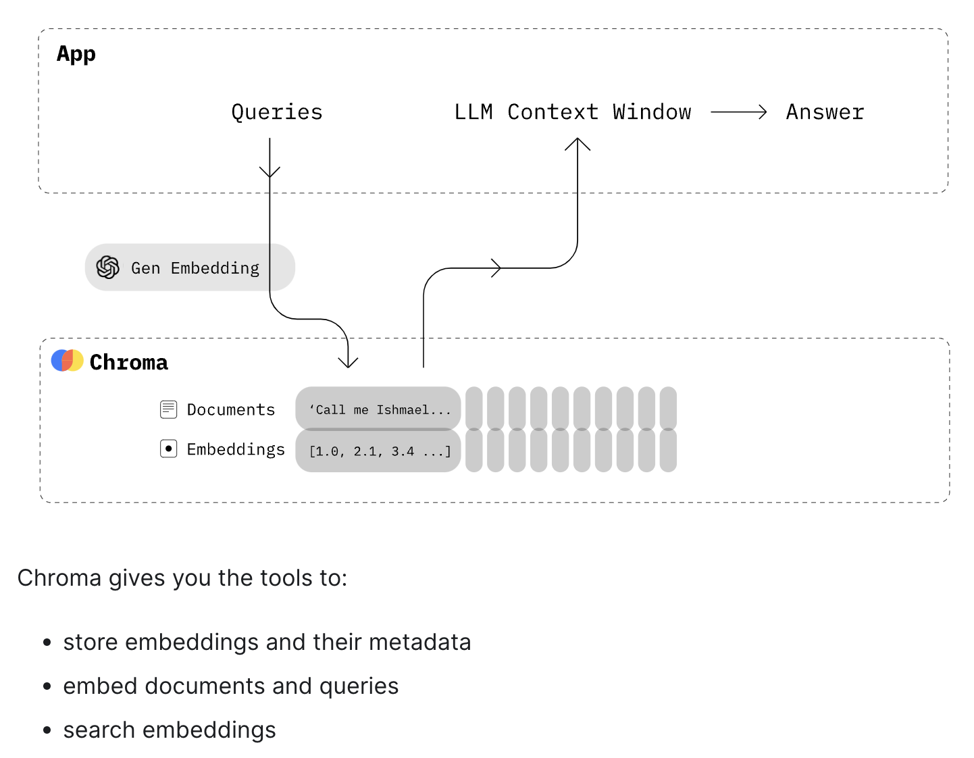
Vector DB
pip install chromadb
Vector DB
Vector DB is a database that stores embeddings of words, phrases, or documents along with their corresponding identifiers.
It allows for fast and scalable retrieval of similar items based on their vector representations.
Vector DBs enable efficient retrieval of relevant information during the retrieval phase of RAG, improving the contextual relevance and quality of generated responses.
Data Chunking: Before the retrieval model can search through the data, it's typically divided into manageable "chunks" or segments.
Vector DB Examples : Chroma, Pinecone, Weaviate, Elasticsearch

Slide 19
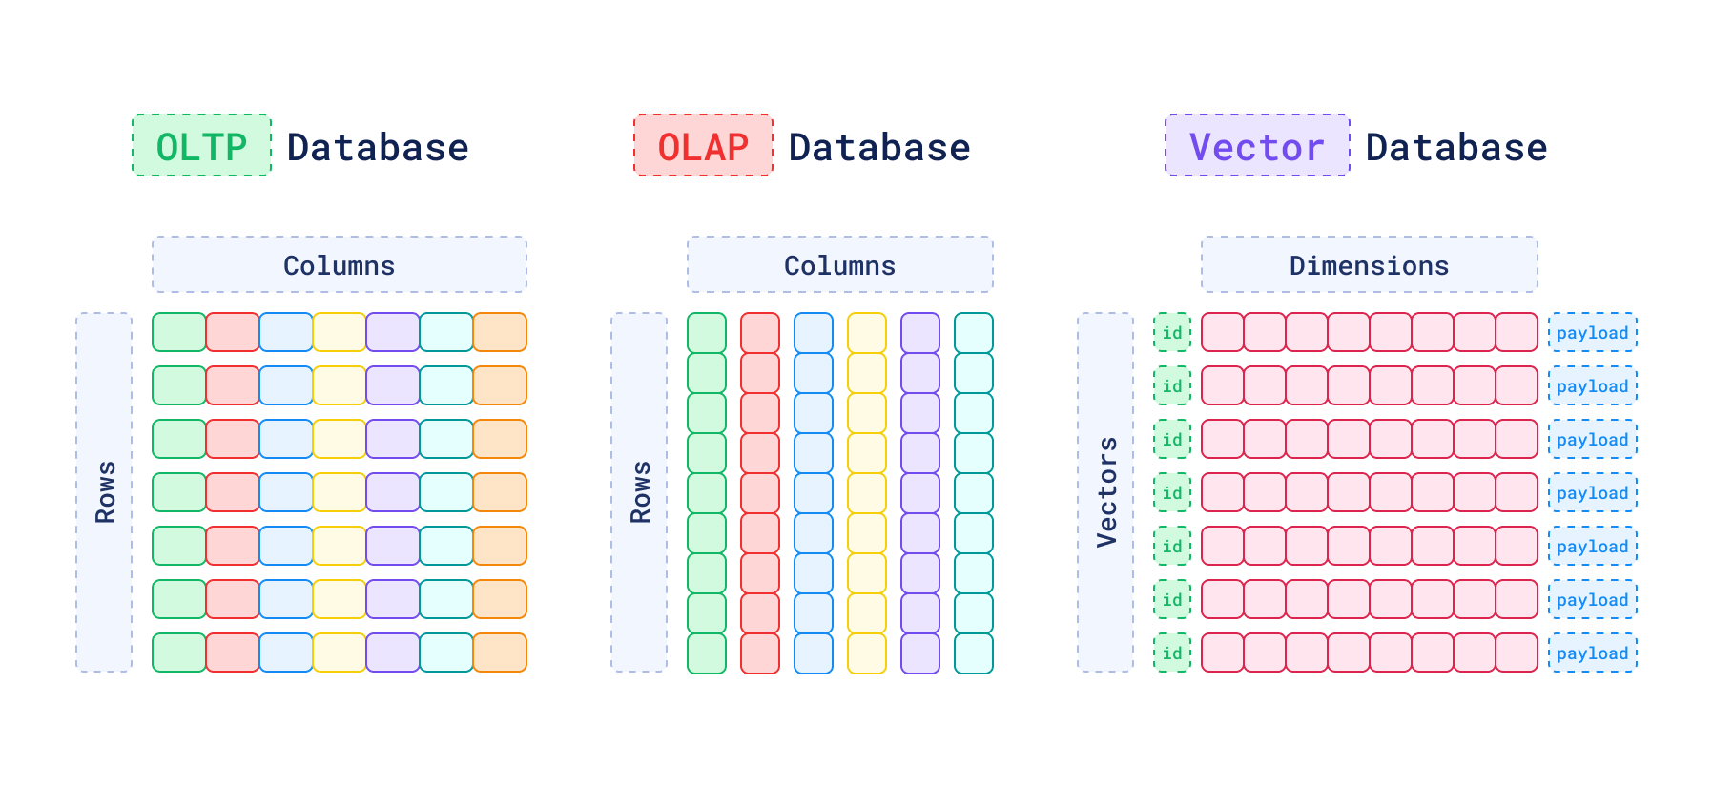
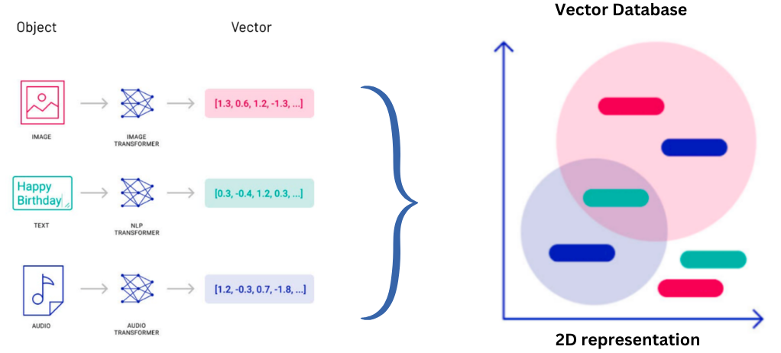

Slide 20
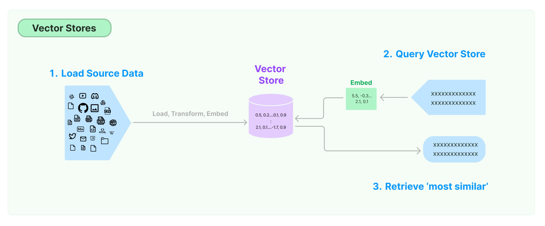
Retriever from Vector Store
RAG Retriever
The next step is to perform a relevancy search. The user query is converted to a vector representation and matched with the vector databases
The retriever component is responsible for efficiently identifying and extracting relevant information from a vast amount of data.
https://python.langchain.com/docs/modules/data_connection/retrievers/

Slide 21
Ranker / Prompt
RAG Ranker
The RAG ranker component refines the retrieved information by assessing its relevance and importance. It assigns scores or ranks to the retrieved data points, helping prioritize the most relevant ones.
The retriever component is responsible for efficiently identifying and extracting relevant information from a vast amount of data.
For example, consider a smart chatbot that can answer human resource questions for an organization. If an employee searches, "How much annual leave do I have?" the system will retrieve annual leave policy documents alongside the individual employee's past leave record.
Augment the LLM prompt
Next, the RAG model augments the user input (or prompts) by adding the relevant retrieved data in context. This step uses prompt engineering techniques to communicate effectively with the LLM.
The augmented prompt allows the large language models to generate an accurate answer to user queries.

Slide 22
Generator
RAG Generator
The RAG generator component is basically the LLM Model such a (GPT)
The RAG generator component is responsible for taking the retrieved and ranked information, along with the user's original query, and generating the final response or output.
The generator ensures that the response aligns with the user's query and incorporates the factual knowledge retrieved from external sources.
Update external data
To maintain current information for retrieval, asynchronously update the documents and update embedding representation of the documents.
Automated Real-time Processes: Updates to documents and embeddings occur in real-time as soon as new information becomes available. This ensures that the system always reflects the most recent data.
Periodic Batch Processing: Updates are performed at regular intervals (e.g., daily, weekly) in batches. This approach may be more efficient for systems with large volumes of data or where real-time updates are not necessary.

Slide 23
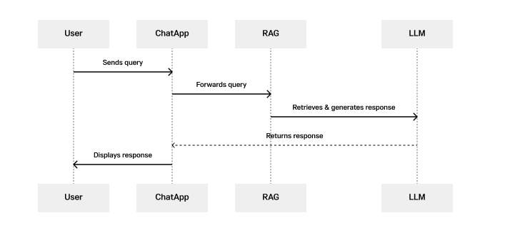
RAG Chat Application
Step 1 - User sends query: The process begins when the user sends a query or message to the chat application.

Slide 24
Step 2 - Chat App forwards query: Upon receiving the user's query, the chat application (Chat App) forwards this query to the Retrieval Augmented Generation (RAG) model for processing.
Step 3 - RAG retrieves + generates response: The RAG model, which integrates retrieval and generation capabilities, processes the user's query. It first retrieves relevant information from a large corpus of data, using the LLM to generate a coherent and contextually relevant response based on the retrieved information and the user's query.
Step 4 - LLM returns response: Once the response is generated, the LLM sends it back to the chat application (Chat App).
Step 5 - Chat App displays responses: Finally, the chat application displays the generated response to the user, completing the interaction.

Slide 25
RAG versus Fine Tuning
Objective
Fine-tuning aims to adapt a pre-trained LLM to a specific task or domain by adjusting its parameters based on task-specific data.
RAG focuses on improving the quality and relevance of generated text by incorporating retrieved information from external sources during the generation process.
Training Data
Fine-tuning requires task-specific labeled data /examples to update the model's parameters and optimize, leading to more time & cost
RAG relies on a combination of pre-trained LLM and external knowledge bases
Adaptability
Fine-tuning makes the LLM more specialized and tailored to a specific task or domain
RAG maintains the generalizability of the pre-trained LLM by leveraging external knowledge allowing it to adapt to a wide range of tasks
Model Architecture
Fine-tuning typically involves modifying the parameters of the pre-trained LLM while keeping its architecture unchanged.
RAG combines the retrieval and generation components, with the standard LLM architecture to incorporate the retrieval mechanism.
https://klu.ai/glossary/supervised-fine-tuning
https://modal.com/blog/llm-fine-tuning-overview

Slide 26
Notebook Example:
https://colab.research.google.com/drive/15Fjv-4trrgFEbhVcGrkz3ZdyXe3PF3Ba
Notes:
flowchart LR
A[Start: Import Dependencies] --> B[Initialize HuggingFace Provided LLM]
B --> C[Send Test/Receive Output]
C --> D[Upload New Data]
D --> E[Process/Split/Token/Embed Data]
E --> F[Put Into Vector DB]
F --> G[Setup RAG Chain]
G --> H[Test RAG Chain]
H --> I[End]
click A "https://python.langchain.com/docs/integrations/llms/huggingface_endpoint/"
click B "https://huggingface.co/models"
click D "https://healthprofessions.stonybrookmedicine.edu/programs/ahi/faculty/hants_williams"
click G "https://langchain.com/docs/guides/rag"

